Slide 1

Leveraging Data Warehousing and Business Intelligence for Analysing Netflix Data: A Comparative Study of Netflix Movies and TV Shows.
GROUP 4:
Jithendhar Karukola Janaki Ram Prasad Adapa Venkata krishna Rohan Dacharla Saran Sai Thota FNU Sneha

Slide 2

INTRODUCTION ABOUT THE DATA

Slide 3

Netflix, a trailblazer in the realm of media and video streaming, has revolutionized the way entertainment is consumed worldwide. With its expansive library comprising over 8,000 movies and TV shows, the platform caters to a diverse audience spanning the globe. Boasting a staggering subscriber base of more than 200 million users, Netflix has firmly established itself as a household name, offering an unparalleled variety of content to suit every taste and preference.

Slide 4
Within this vast dataset lie comprehensive details for each title available on the platform, providing users with valuable insights into cast members, directors, ratings, release years, durations, and more. This wealth of information not only facilitates personalized recommendations and tailored viewing experiences but also underscores Netflix's commitment to delivering high-quality entertainment to its ever-growing audience.

Slide 5
OPPORTUNITY MATRIX
Business Process / Event | Data Collection | Data Preprocessing | Exploratory Data Analysis | Machine Learning Modeling | Performance Evaluation | Insights Generation
Content Recommendation | Marketing Team | Data Analysts | Data Analysts | Data Scientists | Data Scientists | Data Scientists
Content Localization | Market Research | Data Analysts | Data Analysts | Data Scientists | Content Managers | Data Scientists
User Engagement Analysis | Customer Support | Data Analysts | Data Analysts | Data Scientists | Data Scientists | Data Scientists
Content Performance Evaluation | Product Management | Data Analysts | Data Analysts | Data Scientists | Product Managers | Data Scientists

Slide 6
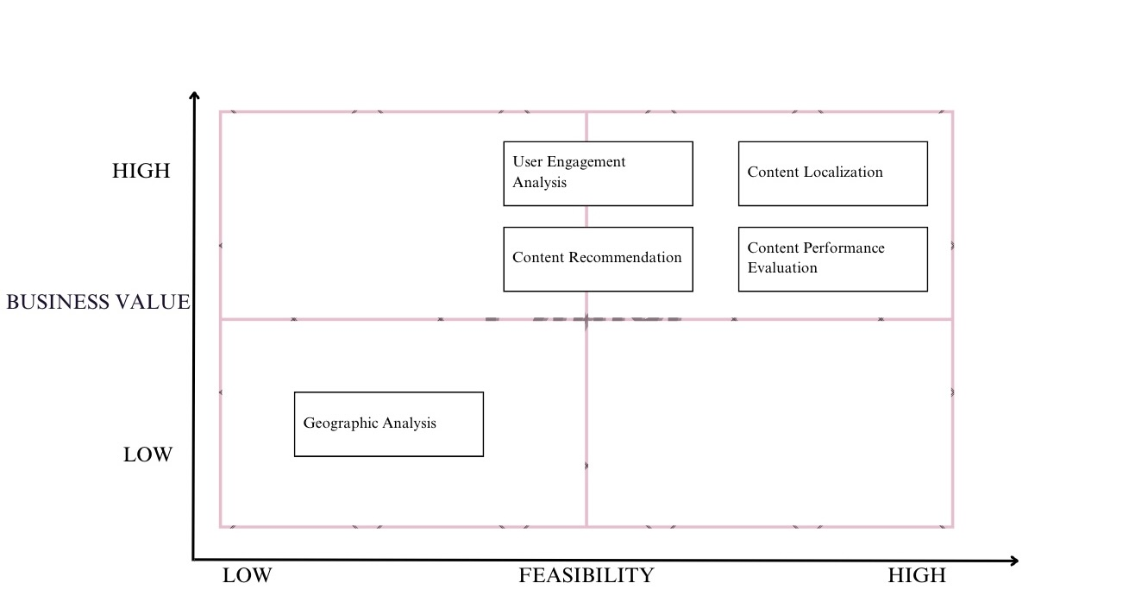
PRIORITIZATION GRID

Slide 7

CONFORMED DIMENSION
Conforming dimension delivery comprises three key stages: standardization, data matching and deduplication, and data filtering or selection. Standardization ensures uniformity in data, while data matching enhances accuracy by identifying and resolving duplicates. Finally, data filtering ensures that only the master data is selected for the delivery of finalized conformed dimension data.

Slide 8
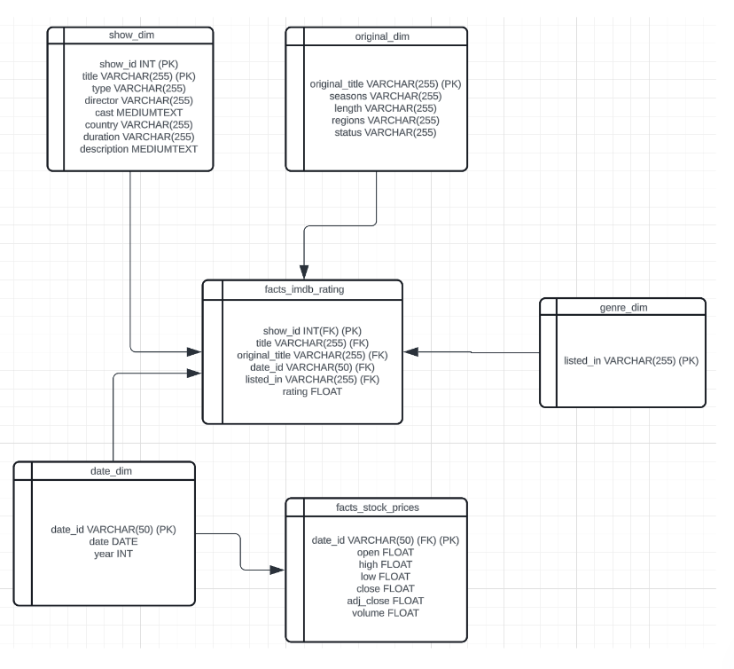
DIMENSIONAL MODEL
The dataset allows us to analyze and study the relationships between Netflix’s movies and shows selection to IMDB scores and their stock prices.

Slide 9

DATA TRANSFORMATION

Slide 10
Post-extraction, the data embarks on a transformative journey, undergoing a meticulous process aimed at refining its quality and enhancing its usability. This phase, nestled within the broader framework of ETL (Extract, Transform, Load) development, assumes a pivotal role in shaping the data into a reliable and coherent resource for downstream analyses and applications. Spanning a spectrum from fundamental tasks like standardizing data types and rectifying spelling errors to more sophisticated techniques such as data cleansing, this transformation phase is characterized by its intricacy and time-consuming nature.

Slide 11
At its core, data transformation entails standardizing data types to foster uniformity and compatibility across the dataset. Beyond mere conversions, it involves rectifying inconsistencies and enhancing clarity to ensure data integrity. This involves not only rectifying spelling errors but also harmonizing terminologies and formatting data to adhere to standard norms. Furthermore, the transformation phase encompasses more advanced techniques such as data cleansing, where duplicate records are identified and anomalies rectified, elevating the overall quality and reliability of the dataset. Together, these efforts culminate in a refined and enriched dataset poised to empower informed decision-making and drive meaningful insights across various domains.

Slide 12
DATA TRANSFORMATION RULES
Selective column loading
Standardizing encoding
Pre-calculation
Optimizing query performance through reordering
Merging data sources to eliminate duplicates
Row-column transformations
Splitting one column into multiple
Consolidating duplicate columns
Pre-connecting data
Validating data integrity.

Slide 13
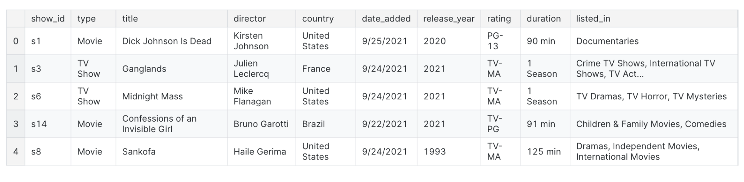
SAMPLE TWO-WAY AGGREGATE TABLE
Here's a sample aggregate table showing total views by month and release type

Slide 14
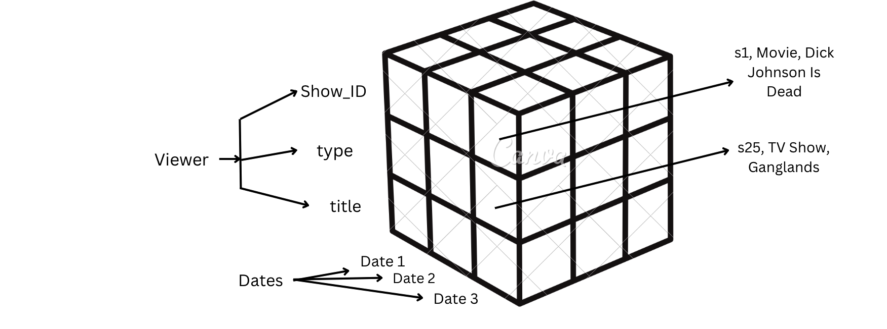
DATA CUBE

Slide 15
USER/TASK ANALYSIS
User Role | Task | Delivery
Data Analyst | Analyze data trends and patterns | Provide insights on viewer preferences, popular genres, and trends
Content Manager | Curate content for the platform | Select and prioritize movies and TV shows for addition or removal
Data Scientist | Develop recommendation algorithms | Implement machine learning models for personalized recommendations

Slide 16
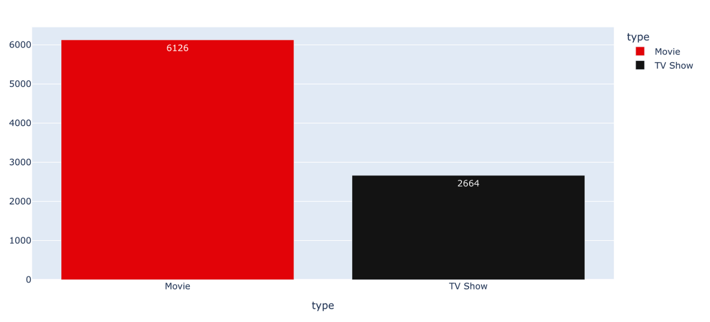
SHOW TYPE

Slide 17
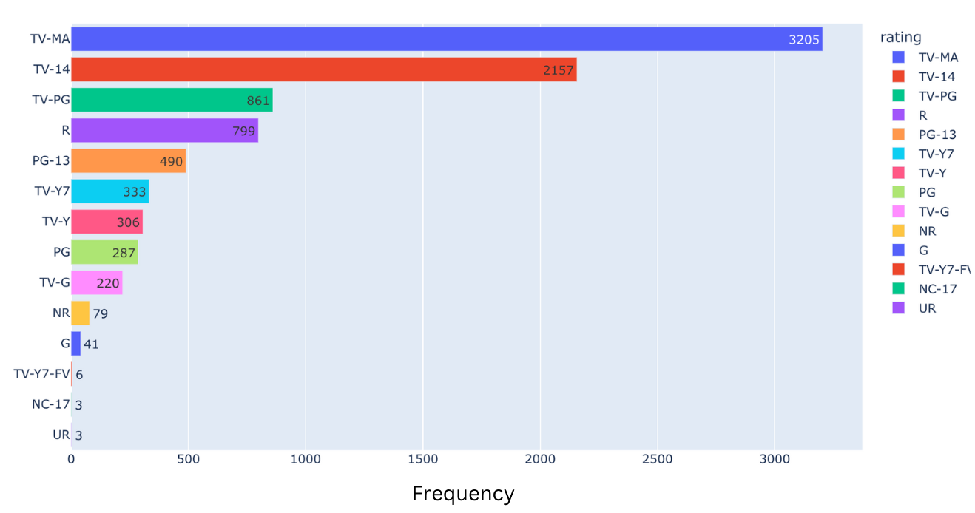
RATING

Slide 18
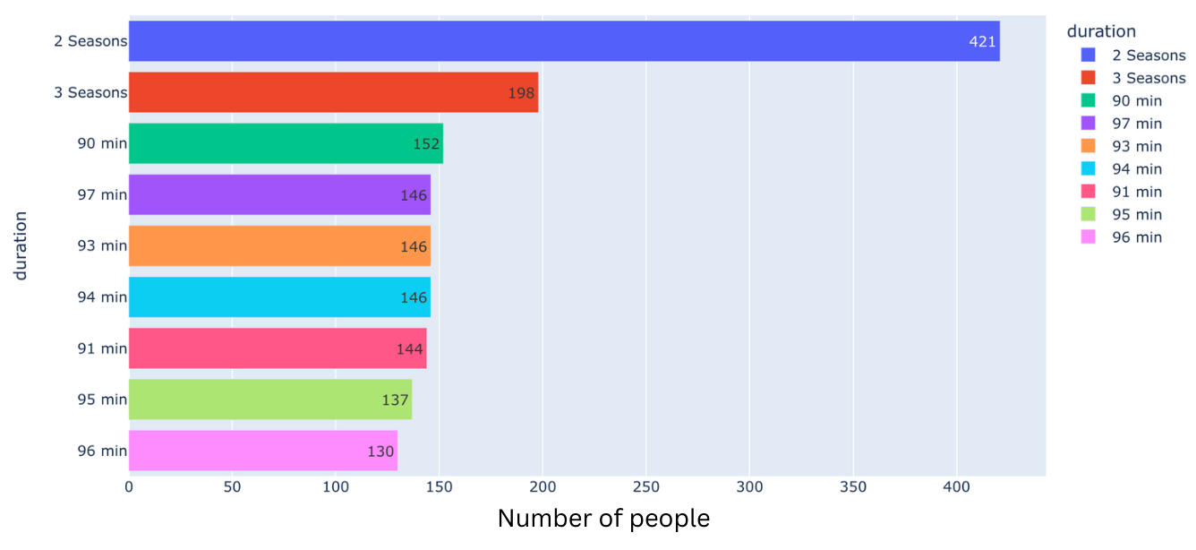
DURATION AND COUNT

Slide 19
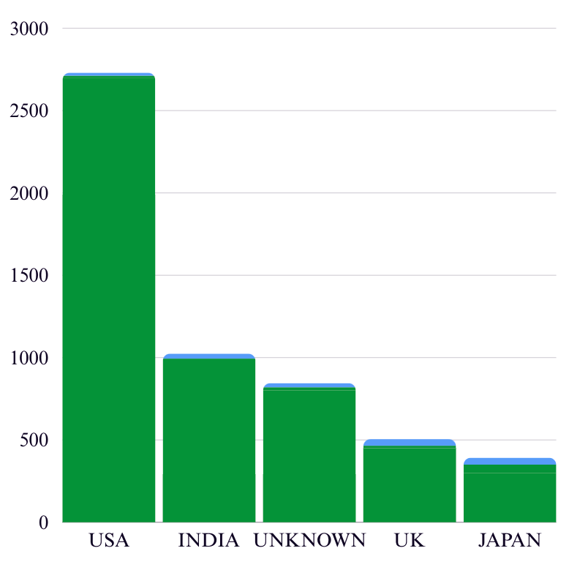
On Netflix, Most of the shows are from USA and India

Slide 20
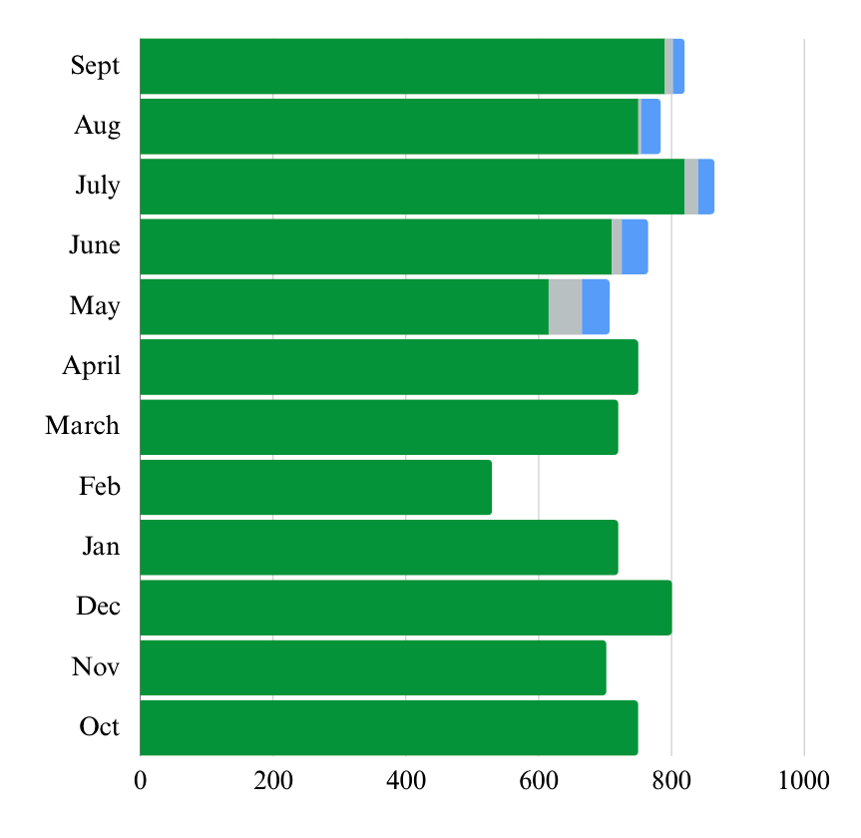
July and December are the months in which most shows are released.

Slide 21
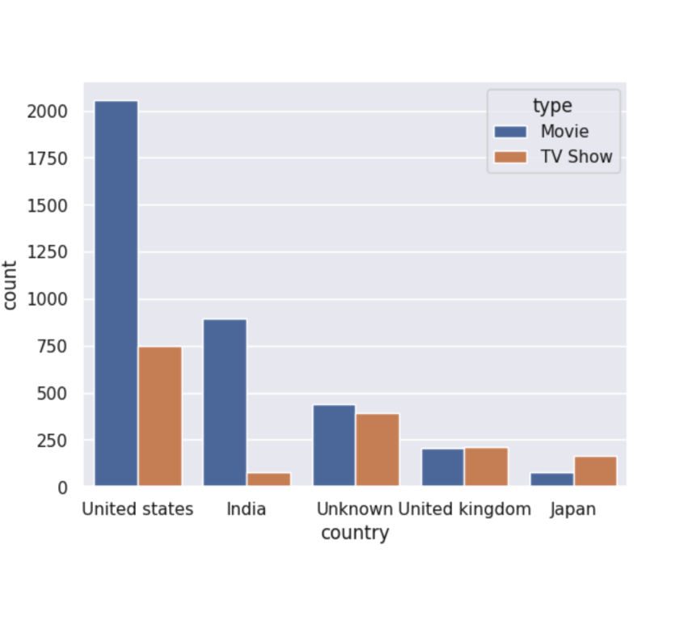
In United states, Movies are more popular than TV shows.
In India, Movies are more popular than TV shows.
In United Kingdom, Movies and TV Show are equally popular.
In Japan, TV Shows are more popular than Movies.

Slide 22

TOP 10 MOVIES AND TV SHOWS DIRECTORS

Slide 23
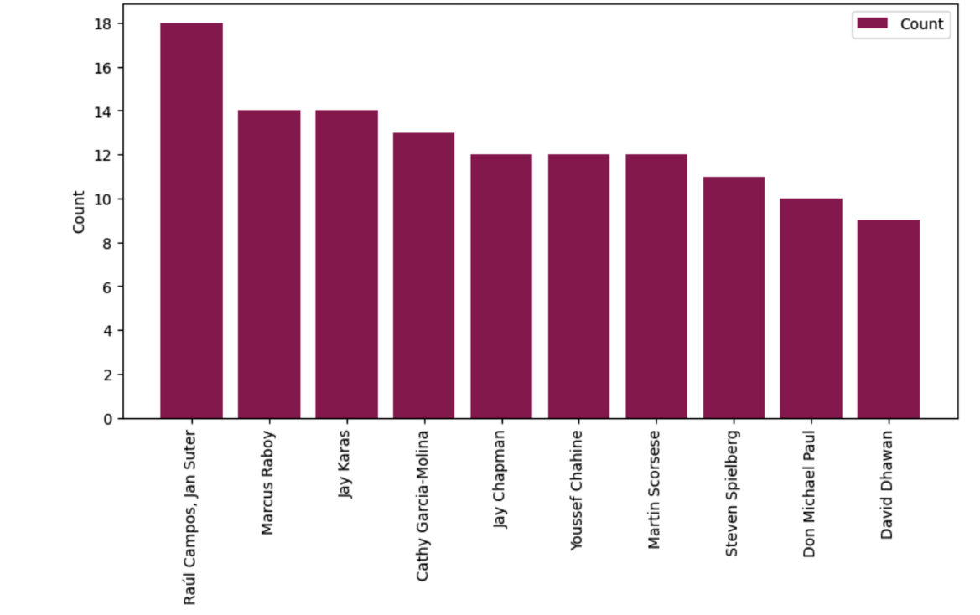
Top 10 Movie and TV Show Directors

Slide 24
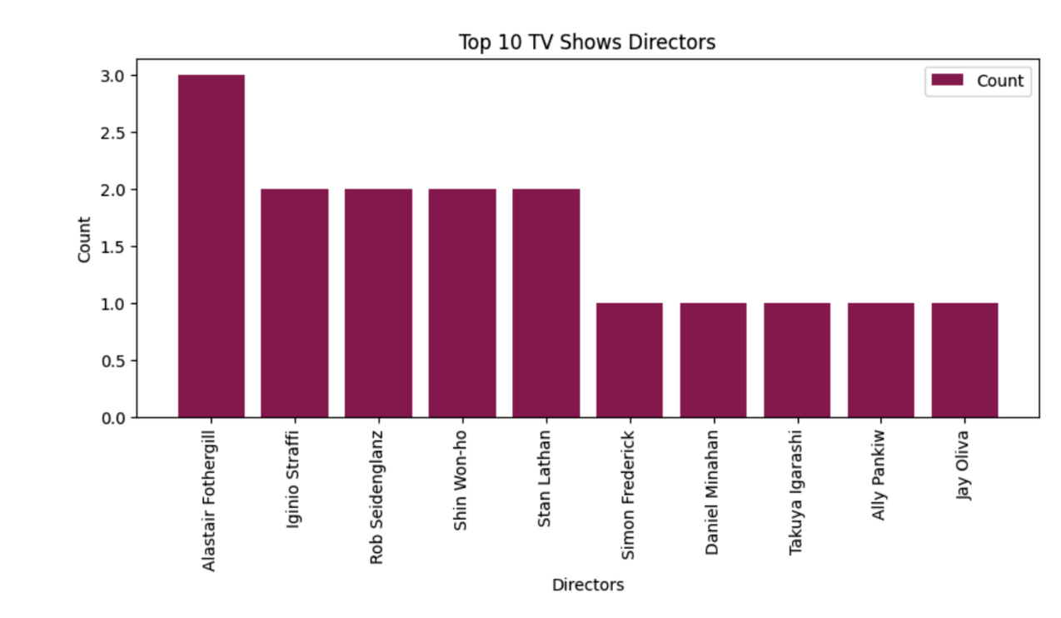

Slide 25

TOP 10 MOVIE AND TV SHOW CATEGORIES

Slide 26
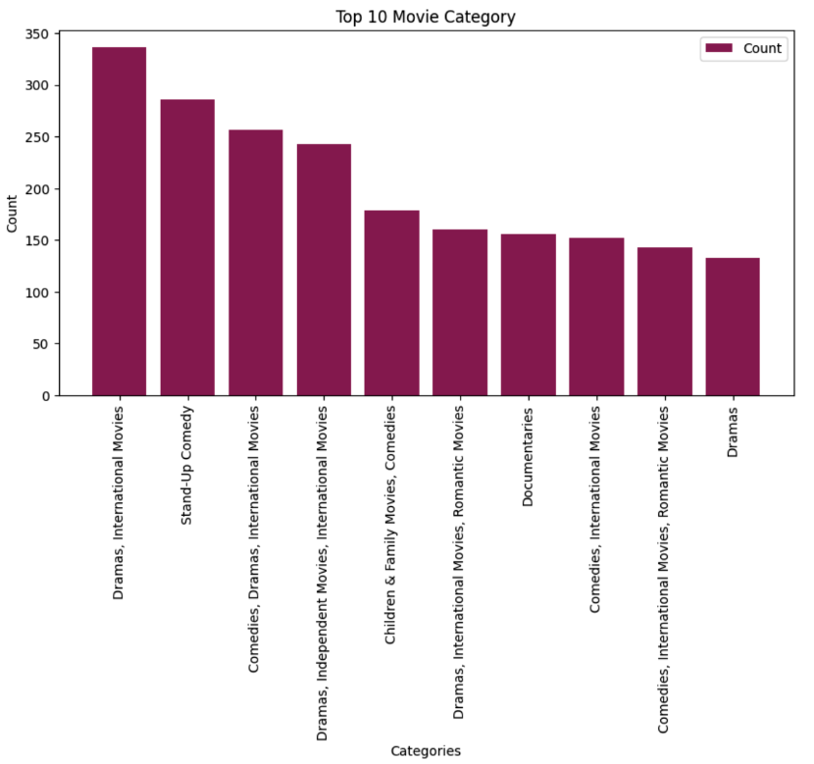

Slide 27
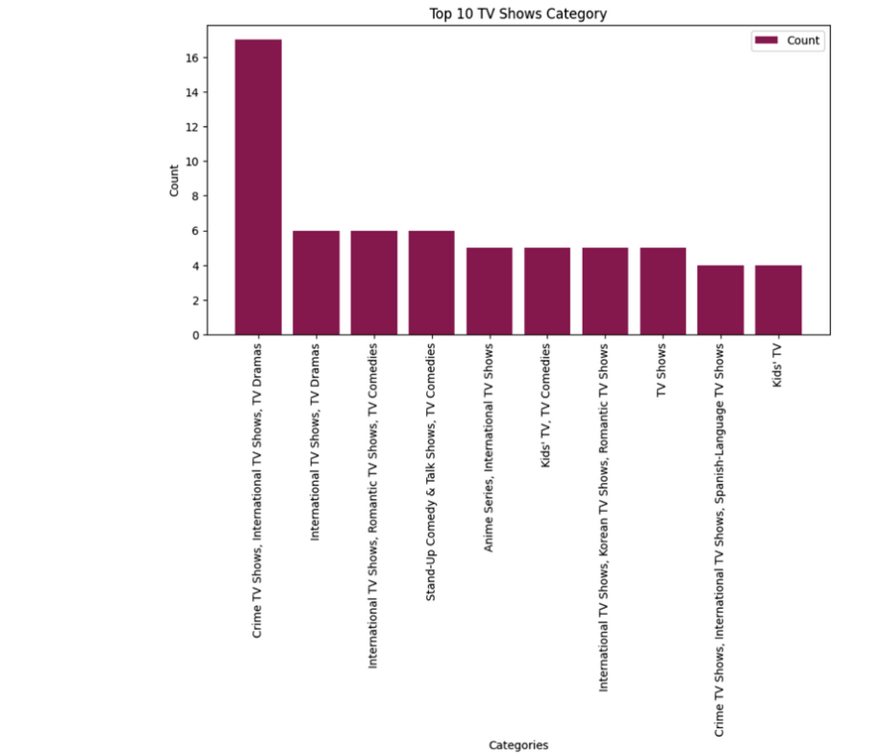

Slide 28

TOP 10 MOVIE AND TV SHOW RATINGS

Slide 29
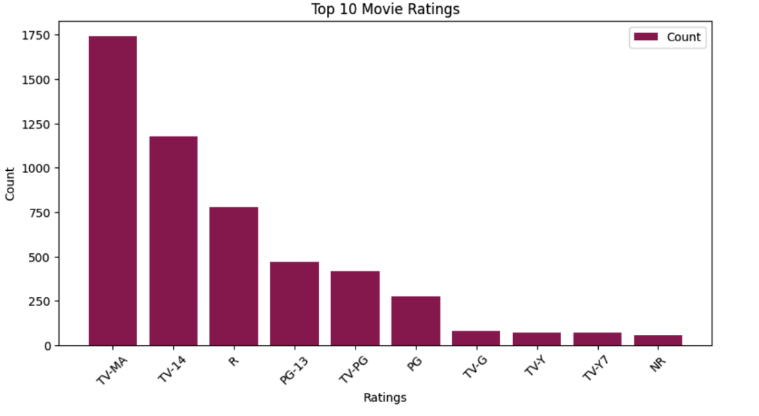

Slide 30
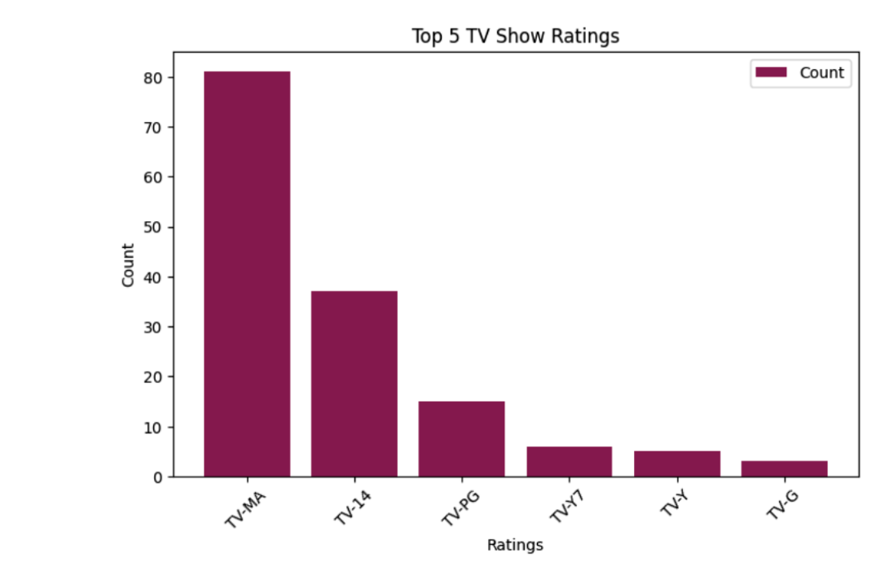

Slide 31

CONCLUSION

Slide 32

Strategic Content Decisions: Analysis aids in making informed decisions on content selection and forecasting viewer preferences.
Viewer Engagement Monitoring: Data analytics helps monitor viewer engagement trends and identify factors influencing audience retention.
Optimal Content Utilization: Comprehensive data enables efficient utilization of content library, ensuring optimal availability and placement of movies and TV shows.

Slide 33
Enhanced Performance Metrics: Analysis of metrics such as viewership, ratings, and genre preferences provides valuable insights for content performance evaluation and decision-making.
Predictive Content Planning: Historical and real-time data analysis facilitates predictive analytics for proactive content planning, production, and acquisition.

Slide 34

THANK YOU

